Slide 1
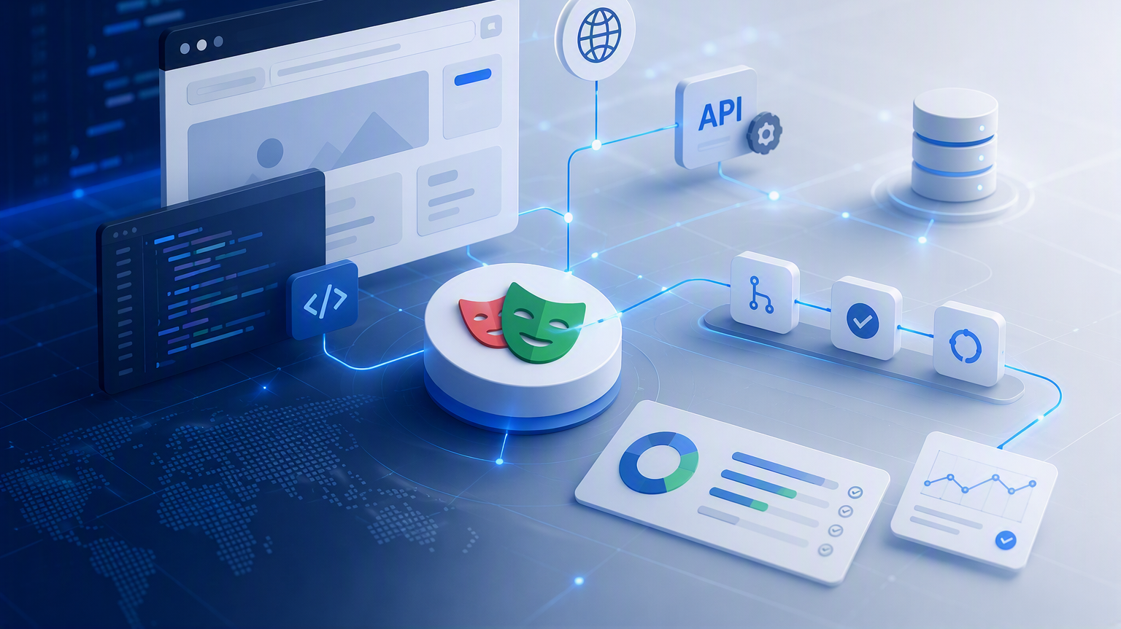

Web automation with playwright
Design Patterns & Framework Architecture
Instructor: Eliana Navia Claros

Slide 2
Web automation with Playwright
Module 4 | Design Patterns & Framework Architecture
Separate responsibilities so the framework becomes stable, readable, and easier to evolve
POM
COMPONENTS
LAYERS
PATTERNS
Model pages
Reuse regions
Separate concerns
Choose intentionally
Main outcome: implement the first Page Object inside a maintainable framework

Slide 3
Design patterns
All patterns can be categorized by their intent, or purpose
1
Creational patterns
2
Behavioral patterns
Take care of effective communication and the assignment of responsibilities between objects.
Provide object creation mechanisms that increase flexibility and reuse of existing code. (Factory, Singleton).
3
Structural patterns
Explain how to assemble objects and classes into larger structures, while keeping the structures flexible and efficient. (Page object, Composite, screenplay)
Design Patterns are typical solutions to commonly occurring problems in software design.

Slide 4
Why use design patterns?
Patterns make a framework more robust and stable
1
Single responsibility
2
Reuse
Each layer changes for one primary reason.
Common UI behavior is implemented once.
3
Isolation
4
Change control
Tests do not share global browser or mutable state.
UI changes have a smaller, predictable impact.
5
Readability
Tests communicate business behavior clearly.
A stable framework localizes change, reduces duplication, and keeps failures diagnosable.

Slide 5
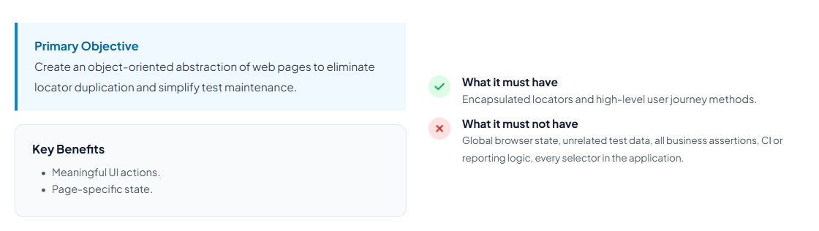
Page Object Model
Model page responsibilities
Clean separation between test code and UI elements’ interaction code.

Slide 6
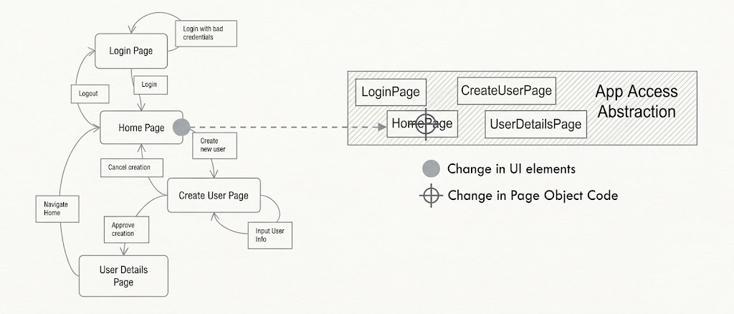
Page Object Model
Model page responsibilities
Clean separation between test code and UI elements’ interaction code.

Slide 7
Page Object implementation
Keep UI mechanics behind meaningful methods
// login.page.ts
export class LoginPage {
constructor(private page: Page) {}
readonly userInput = this.page.locator('#username');
readonly passInput = this.page.locator('#password');
readonly submitBtn = this.page.locator('button[type="submit"]');
async login(user: string, pass: string) {
await this.userInput.fill(user);
await this.passInput.fill(pass);
await this.submitBtn.click();
}
}
Key Design Rules
Accepts Playwright Page instance via constructor.
Exposes readonly locators for flexibility.
Provides high-level semantic methods like login().
Keeps test assertions entirely inside test files.
WEB AUTOMATION FUNDAMENTALS | MODULE 4 | 8

Slide 8
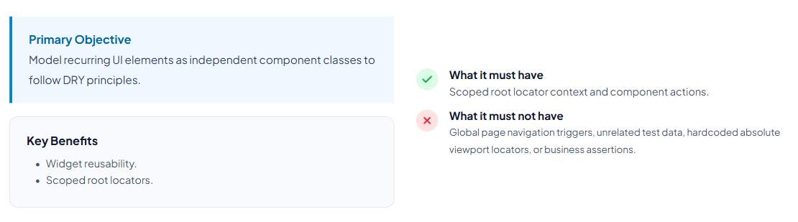
Page Components and composition
Decomposing monolithic pages into reusable modular UI fragments.
Compose objects into tree structures and then work with these structures as if they were individual objects

Slide 9
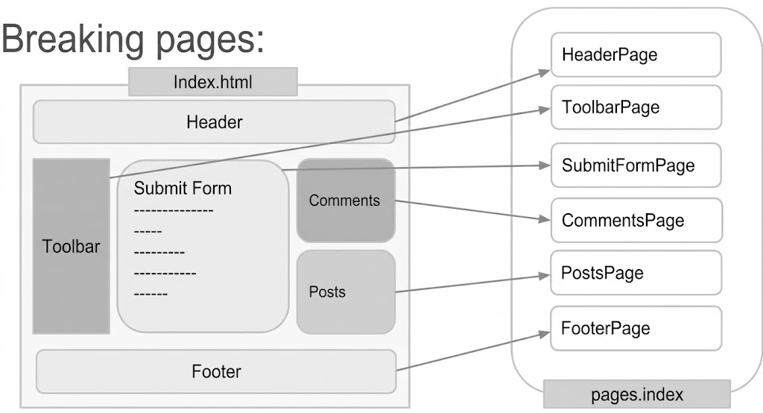
Page Components and Composition
Decomposing monolithic pages into reusable modular UI fragments.
Compose objects into tree structures and then work with these structures as if they were individual objects

Slide 10
Page Components and composition implementation
Model reusable regions inside pages
Composition prevents…..
Repeated widget selectors.
Large God Page classes.
Duplicated menu behavior.
Unclear ownership of regions.
Benefits
Scoped locators prevent selector collision across the DOM.
Components can be instantiated on multiple distinct pages.
Changes in a shared widget require updates in only one file.
Improves code readability through hierarchical structure.
export class HeaderComponent {
constructor(private readonly root: Locator) {}
async signOut() {
await this.root.getByRole('menuitem',
{ name: 'Sign out' }).click();
}
}
export class DashboardPage {
readonly header: HeaderComponent;
constructor(page: Page) {
this.header = new HeaderComponent(page.getByRole('banner'));
}
}
Page = URL responsibility. Component = reusable region.

Slide 11
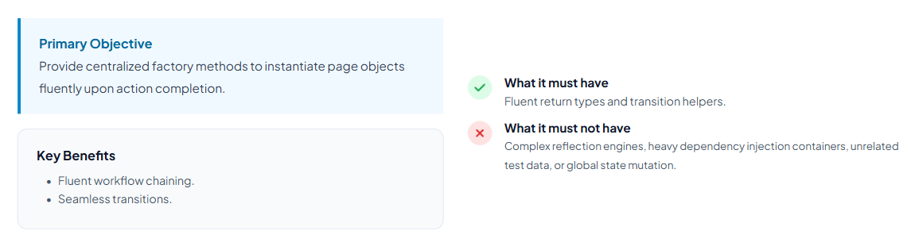
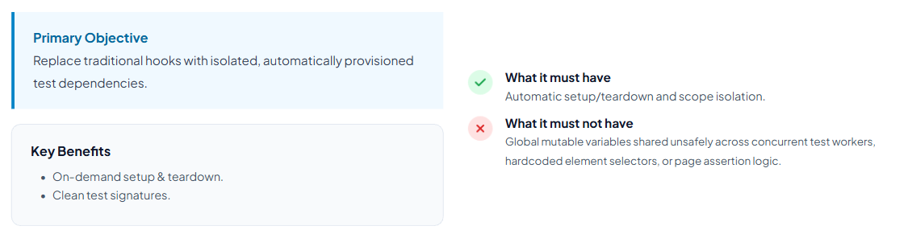
Page Factory and fixtures
Creation design pattern
Solves the problem of creating product objects without specifying their concrete classes.

Slide 12
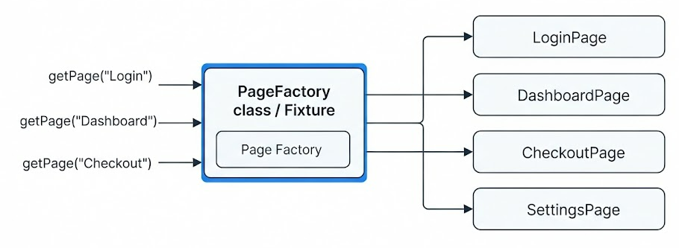
Page Factory and fixtures
Centralizing dynamic page object creation and navigation flows
Dynamically create and return page object instances based on user flow or page state.

Slide 13
Page Factory and fixtures implementation
Creation is different from lifecycle management
export function createPages(page: Page) {
return {
login: new LoginPage(page),
dashboard: new DashboardPage(page),
};
}
// Factory: creates objects
// Fixture: injects objects, setup, and teardown
Use Factory when...
Object construction repeats.
Several page variants exist.
Shared configuration must be assembled.
Creation logic needs one owner.
Factory creates. Fixture controls lifecycle.

Slide 14
Screenplay Pattern
Model user goals when pages no longer explain the domain
await actor.attemptsTo(
SignIn.withCredentials(email, password)
);
await actor.asksFor(
Dashboard.title()
);
Core concepts
Actor
Ability
Task
Interaction
Question
Use when...
Many user roles.
Complex cross-page workflows.
Business tasks need strong reuse.
Models business goals across pages.
Do not add Screenplay when POM already solves the real problem.

Slide 15
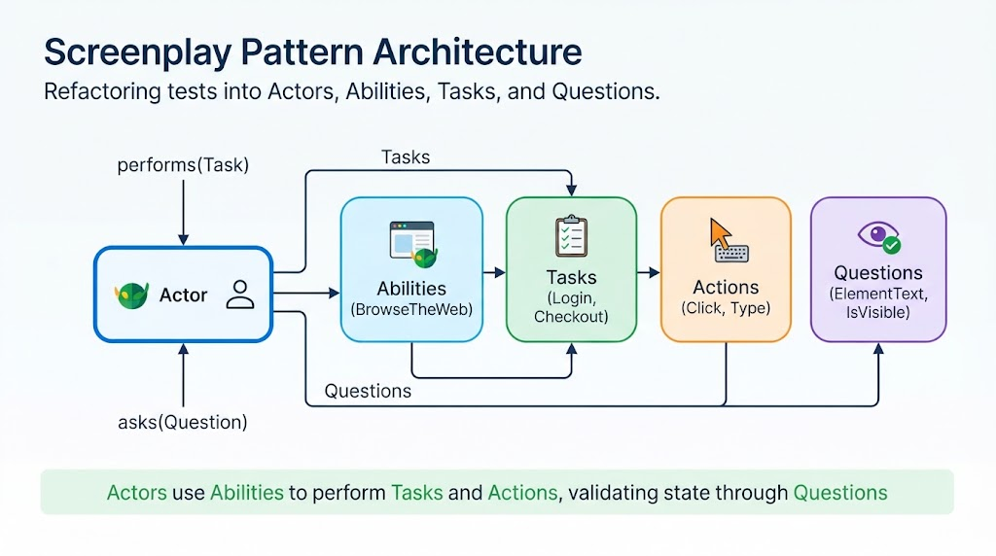
Screenplay Pattern
Model user goals when pages no longer explain the domain

Slide 16
Anti-patterns to avoid
Patterns should reduce complexity, not create it
Common anti-patterns
Design test
God Page classes.
One class for every trivial selector.
Static or global browser state.
Assertions hidden in generic methods.
Factories that hide all setup.
Screenplay used only for fashion.
Does this abstraction:
remove real duplication?
clarify responsibility?
reduce change impact?
keep failures diagnosable?
make the test easier to read?
WEB AUTOMATION FUNDAMENTALS | MODULE 4 | 12

Slide 17
When and why to use each pattern
Select the simplest suitable abstraction
1
Page Object
2
Page Component
Pages and straightforward flows | Clear UI boundary
Repeated widgets or regions | Local reuse
3
Page Factory
4
Screenplay
Repeated construction/configuration | Consistent assembly
Roles and cross-page goals | Business-oriented reuse
Progression
Start simple → POM → Components → Factory when needed → Screenplay for complex goals
These patterns can be combined; they are not mutually exclusive.

Slide 18
Core Components of an Automation Framework
Framework Components - A framework is more than a browser tool
Test runner
Assertions
Locators
Test data
Fixtures
Configuration
Pages / actions
Reports & CI
Quality criteria
Can a new teammate run it quickly? | Are failures understandable? | Can tests run independently in CI?
Project direction: Playwright + TypeScript + Chromium + GitHub Actions

Slide 19
Analize codegen test case
Move from a working test to a maintainable design
npx playwright codegen https://www.saucedemo.com/
// Generated draft
import { test, expect } from '@playwright/test';
test('test', async ({ page }) => {
await page.goto('https://www.saucedemo.com/');
await page.locator('[data-test="username"]').click();
await page.locator('[data-test="username"]').fill('standard_user');
await page.locator('[data-test="password"]').click();
await page.locator('[data-test="password"]').fill('secret_sauce');
await page.locator('[data-test="login-button"]').click();
await expect(page.getByText('Swag Labs')).toBeVisible();
await expect(page.locator('[data-test="inventory-container"]')).toBeVisible();
});
What needs a boundary?
UI locators are mixed with business intent.
Navigation and actions may be repeated.
UI changes can affect many tests.
The test has no clear UI responsibility.
Codegen creates a draft; engineering creates the test.

Slide 20
tsconfig.json and imports
Configure TypeScript and keep imports maintainable
{
"compilerOptions": {
// Path aliases — relative paths
"paths": {
"@pages/*": ["./src/ui/pages/*"],
"@fixtures/*": ["./src/fixtures/*"],
"@api/*": ["./src/api/*"],
"@helpers/*": ["./src/helpers/*"],
"@data/*": ["./data/*"],
"@config/*": ["./src/config/*"]
}
}
Defines the root of the project and specifies the compiler options.
Compiler configuration: defines how the TypeScript compiler (tsc) should behave.
Type Safety & strictness: Enables strict type-checking rules.
Module resolution: Configures how modules are resolved.
IDE integration: Provide accurate auto-completions.
File Inclusion/exclusion: Defines which files and directories are included in the compilation.
Module resolution
import { LoginPage }
from '@pages/LoginPage';
Keep paths documented and consistent.
Run type checking before accepting changes.

Slide 21
package.json and execution scripts
Shortcuts make team execution consistent
{
"scripts": {
“typecheck": “tsc --noEmit",
"test": "playwright test",
"test:headed": "playwright test --headed",
"test:debug": "playwright test --debug",
"test:smoke": "playwright test --grep @smoke",
"report": "playwright show-report"
}
}
>> npm run <script-name>
Why scripts matter
Same commands for every developer.
Discoverable test selection.
Local and CI consistency.
No need to remember long commands.
Scripts can be reviewed and versioned.

Slide 22
.env and environment values
Keep URLs, users, and secrets outside the code
# .env.example
BASE_URL=
TEST_USER_NAME=
TEST_USER_PASSWORD=
// src\config\env.ts
Validate required variables and export typed values.
// playwright.config.ts
baseURL: Env.base_Url
import { ENV } from '../src/config/env';
// Credentials
const user = ENV.testUser.name;
const pass = ENV.testUser.password;
Rules
Commit .env.example, not .env.
Never commit real credentials.
Use CI variables and secrets.
Validate required values at startup.
Configuration changes by environment; test intent should not.
npm install dotenv --save-dev
WEB AUTOMATION FUNDAMENTALS | MODULE 3 | 9

Slide 23
playwright.config.ts
The center of project execution
export default defineConfig({
testDir: './tests',
timeout: 30_000,
expect: { timeout: 10_000 },
forbidOnly: !!process.env.CI,
reporter: [['list'], ['html', { open: 'never' }]],
use: {
baseURL: Env.base_Url,
headless: true,
trace: 'retain-on-failure',
screenshot: 'only-on-failure'
},
projects: [{ name: 'chromium' }]
});
Configuration controls
Discovery and timeouts.
Browsers and devices.
Headed or headless mode.
Reports and failure evidence.
CI safety such as forbidOnly.

Slide 24
AI skills across the automation lifecycle
Planned capabilities in stages: Requirements & Story Analysis - Test Design & Architecture
Token Impact
Role
Task Skill
Main Objective
Medium
requirements-analyst
pbi-problem-understanding
Analyze a PBI or feature request to identify edge cases, system behavior, and domain constraints.
Low
requirements-analyst
pbi-creator
Draft structured PBIs (user stories, description, acceptance criteria) from unstructured problem statements.
Medium
requirements-analyst
tc-generator
Generate plain-English Test Cases aligned with PBI acceptance criteria and Playwright annotation standards.
Low
playwright-arch
automation-architect
[Hub] Full architecture enforcement — reviews, auto-fixes, and scaffolds Page Objects, fixtures, and specs.
Medium
playwright-arch
pom-architect
[POM] Enforces Page Object structure: BasePage, locator getters, async actions, and folder placement.
Medium
playwright-arch
test-standards
[Standards] Enforces test rules: path aliases, fixture pattern, naming conventions, and data hygiene.
The skill is not the prompt. It is the repeatable engineering practice plus reviewable evidence.

Slide 25
Skills as development checkpoints
Repeatable, auditable, consistent
Why create a skill
When you have a process you repeat across sessions — a review, a scaffold, a check — and you want the agent to follow it consistently every time, with predictable output.
When to create one
The task has clear steps and a defined result
You'd otherwise explain the same rules every time in chat
You need reproducible output — for evidence, review, or team alignment
The logic is too specific or too long to live in a steering file
When NOT to
It's a one-off task
General context is enough — use steering instead
The process changes too often to lock down
GOAL
→ what it exists for, when to load it
STEPS / RULES
→ what to verify or execute
→ what to auto-fix vs. report only
→ in what order
OUTPUT
→ how to format the result
Section | What it defines
Frontmatter description | The goal — when the agent loads it
## Rules | The steps — what to check, with ✅/❌ examples
Decision Table | The validations — severity and whether auto-fix applies
## Output Format | The output — exact format of each finding
Moment | How to activate
Before committing | Trigger manually: apply architecture
When creating a new page | Trigger: scaffold LoginPage
On every file save | Hook: PostFileSave → runs the relevant sub-skill
After completing a spec task | Hook: PostTaskExec → runs test-standards
During PR review | Trigger manually and paste output as review evidence
Design the skill once, activate it at the right moment in the workflow — not on every prompt, but at the checkpoints where consistency matters.

Slide 26
automation-architect
Result of execution skill
Verified — existing files
tsconfig.json path aliases + ES2022 + strict
playwright.config.ts dotenv, baseURL from env, reporters
.env / .env.example BASE_URL, TEST_USERNAME, TEST_PASSWORD
tests/example.spec.ts BEFORE — raw page.*, hardcoded creds
Created — new files
src/data/auth.data.ts [new]
src/ui/pages/BasePage.ts [new]
src/ui/pages/LoginPage.ts [new]
src/fixtures/index.ts [new]
tests/example.spec.ts [refactored]
[automation-architect] PIPELINE COMPLETE
pom-architect: 0 violations getters [OK] BasePage [OK] no expect() [OK]
test-standards: 0 violations @fixtures [OK] aliases [OK] no hardcoded creds [OK]
[automation-architect] ALL rules satisfied — 6 files, 0 violations, 0 manual fixes.
Created — new files
src/config/Env.ts — validates required env vars at startup.
src/data/auth.data.ts — SauceDemo users; password read from Env.
src/ui/pages/BasePage.ts — abstract class, protected page, navigate().
src/ui/pages/LoginPage.ts — extends BasePage, locators as getters, login().
src/fixtures/index.ts — loginPage + authenticatedPage fixtures.
tests/example.spec.ts — refactored: @fixtures, @data, describe block.

Slide 27
Recommended project structure
Make responsibilities discoverable
web-automation/
├── .github/workflows/
├── data/,
├── test-data/ # JSON, CSV
├── assets/ # pdfs, jpgs
├── docs/
├── tests/ui/ # Test cases
├── src/ # Reusable modules, abstractions, and configuration
├── api/ # API setup and clients
├── client/
├── endpoints/
├── config/ # Environment settings
├── fixtures/ # Setup and teardown(lifecycle)
├── helpers/ # Generic utilities
├── models/
├── ui/ # UI elements wrappers
├── pages/ # Page Objects
├── page.labels.ts
├── components/ # Reusable UI regions
├── .env.example
├── package-lock.json
├── package.json
├── playwright.config.ts
├── tsconfig.json
├── README.md
├──.gitignore
Layers
tests: executable test cases.
ui: UI locators and mechanics.
playwright.config: runner and browser behavior.
package.json: dependencies and scripts.
tsconfig: TypeScript rules and paths.
env: runtime values outside code.
README: team usage and commands.
File Naming Convention – Dot Notation
Pattern: <feature>.<type>.ts
The middle segment communicates the file's role — no need to open it.
login.page.ts
login.labels.ts
login.spec.ts
Scales to any file type:
user.types.ts # interfaces & types
date.utils.ts # helper functions
api.constants.ts # constants
login.labels.ts # login UI text.

Slide 28
Module 4 | Session Summary
Module objectives, Wrap-Up, Key Takeaways
1
Explain why design patterns improve stability and maintainability.
2
Understand the main configuration files.
3
Separate test cases, UI wrappers, business actions, data, and utilities.
4
Compose Page Objects with reusable Page Components.
5
Understand Page Factory and Fixtures trade-offs.
6
Build domain-specific AI skills to stage: Test Design & Architecture.
Patterns are tools for responsibility boundaries—not goals by themselves.

Slide 29
Module 4 | Activities
Assignments & Next Steps
Student tasks
Evidence to submit
PROJECT CONFIGURATION
Configure tsconfig.json — strict, ES2022, path aliases (@pages, @fixtures, @data, @config).
Create .env from .env.example — fill BASE_URL, TEST_USERNAME, TEST_PASSWORD.
Configure playwright.config.ts — load dotenv, set baseURL, reporters, browser projects.
Create src/config/Env.ts — validate required variables at startup with descriptive errors.
PAGE OBJECT MODEL
Define page responsibility — locators and actions in Page; assertions in spec.
Create src/ui/pages/LoginPage.ts extending BasePage — locators as getters, async actions.
Register fixtures in src/fixtures/index.ts (loginPage, authenticatedPage).
Keep business assertions visible in spec — no expect() inside Page Objects.
Run automation-architect skill — verify zero violations in pom-architect and test-standards.
SCREENSHOTS OF GENERATED FILES
src/ui/pages/LoginPage.ts — locators as get properties and login() action visible.
src/fixtures/index.ts — loginPage and authenticatedPage fixtures registered.
tests/example.spec.ts — refactored spec: imports from @fixtures and @data, describe block.
TEST EXECUTION EVIDENCE
Playwright HTML report — all tests passing on Chromium.
automation-architect skill output — pom-architect: 0 violations, test-standards: 0 violations.
Before/after comparison of example.spec.ts showing the refactoring applied.
Next Module:
Development Lifecycle & Team Practices
Build automation that teams can understand, review, and maintain
The goal is justified architecture—not the maximum number of classes.

Slide 30
Module 4 | References
https://refactoring.guru/design-patterns
https://refactoring.guru/design-patterns/csharp
https://refactoring.guru/design-patterns/factory-method
https://refactoring.guru/design-patterns/composite
https://refactoring.guru/design-patterns/singleton
https://martinfowler.com/bliki/PageObject.html
https://webdriver.io/docs/pageobjects/

